Slide 1
Global Trends
Project
Presentation
by Yash Kumar

Slide 2
Gapminder Overview
Gapminder mission is to fight devastating ignorance with a fact-based worldview everyone can understand.
Gapminder identifies systematic misconceptions about important global trends & proportions and uses reliable data to develop easy to understand teaching materials to rid people of their misconceptions.
Gapminder combines data from multiple sources into unique coherent time-series that can’t be found elsewhere. Most of their data are not good enough for detailed numerical analysis. They are only good enough to revolutionize people’s worldview, but they only fill in gaps whenever they believe they know roughly what the numbers would have been, had they existed. The uncertainties are often large.

Slide 3

Problem Statement
The modern world is shaped by complex dynamics in population, health, & economics, making understanding these trends vital for informed policy-making.
GlobalTrends, a leading analytics firm, is dedicated to deciphering these patterns through a comprehensive analysis of the Gapminder dataset.
Your role in this project is to conduct an in-depth Exploratory Data Analysis (EDA), uncovering the intricate relationships between demographic changes, economic development, and health advancements over recent decades.

Slide 4
Process Flow
Data Storage and Manipulation
Data Analysis and Visualization
Data Consolidation and Preprocessing
Objectives and Documentation

Slide 5
Let’s dive into globe’s data !
Gapminder dataset combines data from multiple sources into unique coherent time-series that can’t be found elsewhere.
Most of their data are not good enough for detailed numerical analysis.
My excel sheet Gapminder_Dataset unveils data of countries and their trends discussed in this presentation.

Slide 6
Data Manipulation & Preprocessing
Transformed & Manipulated data using python’s Numpy & Pandas library
Fixed inconsistent values Corrected data type of ‘year’ column to datetime in ‘YYYY-MM-DD’ format
Checked missing/error values Checked the Errors & Null values throughout dataset and filled with appropriate values.
Generated new data and measures - Extracted decade that ‘year’ falls in new column ‘decade’ - Categorized the 'life_exp' into 4 equally ranged bins from 'Low' to 'Very High' in new column

Slide 7
Data Analysis & Visualization
Conducted Exploratory Data Analysis (EDA) using Pandas after converting the dataset into a DataFrame.
Utilized Seaborn and Matplotlib libraries to create visualizations and generate various graphs for effective data representation & insights.

Slide 8
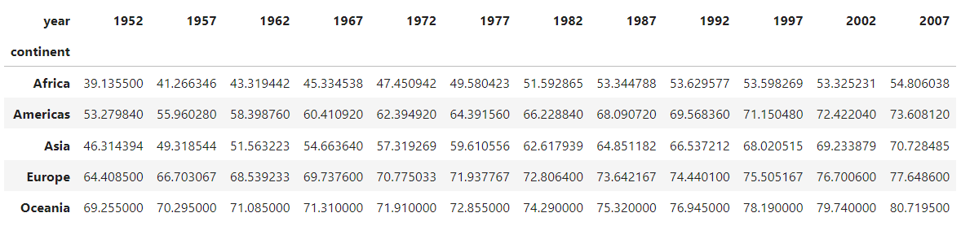
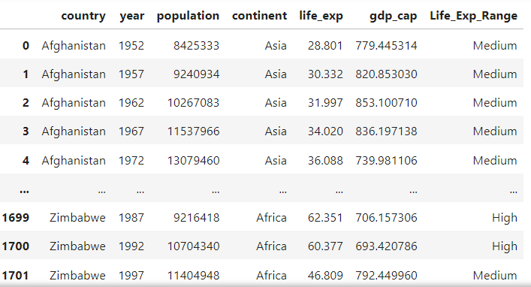
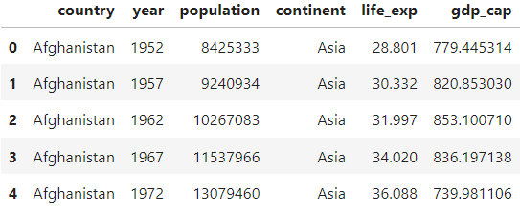
Pivot Table & Outputs

Slide 9
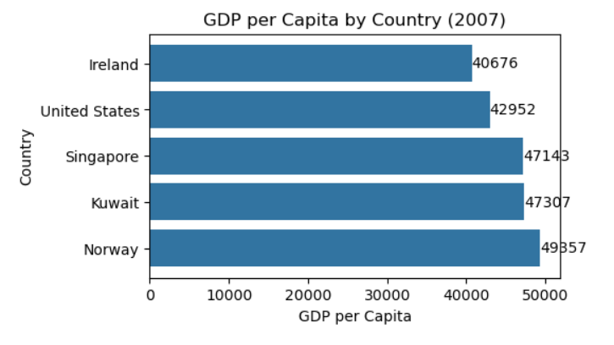
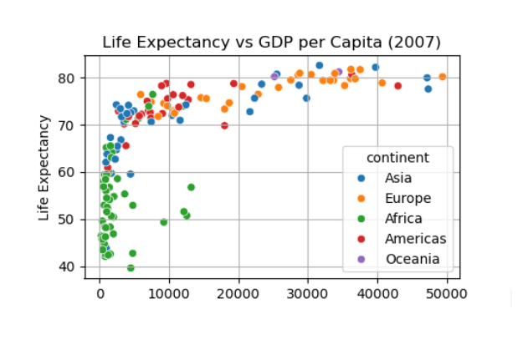
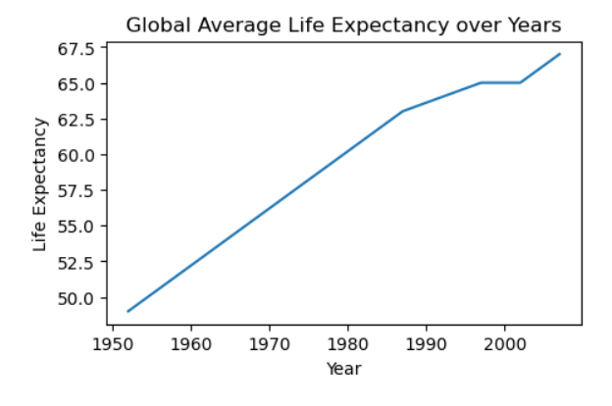
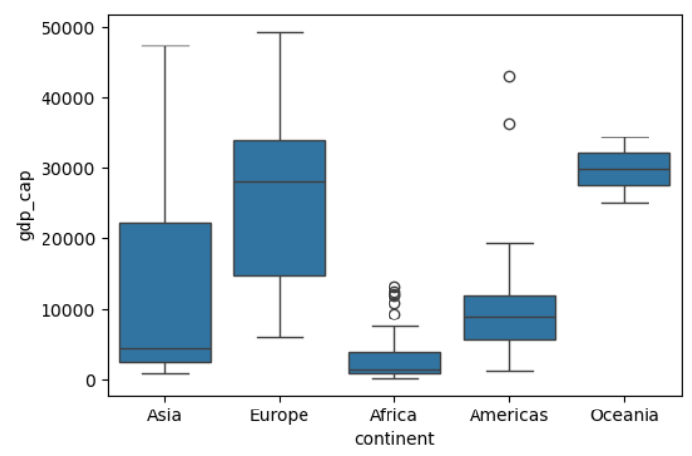
Graphs
all graphs and tables in detail & explanation can be accessed in documented file

Slide 10

Statistical Insights
Total Countries: 142
Total Population: 6.25 B (as of 2007)
Countries (Life Exp > 80 years): 13 (as of 2007)
Avg Life Expectancy: 67yr (as of 2007)
Avg GDP per capita: $ 11.7K (as of 2007)

Slide 11
Key Insights
Top 5 countries with highest GDP per Capita (as of 2007): Norway, Kuwait, Singapore, United States, Ireland
There is a positive correlation between GDP per capita and life expectancy. As GDP per capita increases, life expectancy also tends to increase.
Countries with higher economic development (higher GDP per capita) tend to have better health outcomes, as indicated by higher life expectancy.
- European countries are the most tightly clustered, suggesting a more uniform standard of living and health outcomes across the continent. - African countries are more spread out, indicating more variability in economic and health outcomes
- The average GDP per capita for Oceania is higher than the Americas because Oceania includes countries which have very high GDP per capita. - In contrast, the Americas include a mix of countries with varying levels of GDP per capita, including some with much lower GDP per capita, which brings down the average.

Slide 12
Documentation
Determining Trends, Insights, Issues and Documenting it
Includes all objective questions with Solutions
All subjective questions with graphs, trends and inferences
Doc_File

Slide 13
Conclusion
There’s strong link between economic prosperity (GDP per capita) and health outcomes (life expectancy), with clear disparities across different continents. While higher GDP per capita generally correlates with higher life expectancy, there are significant regional variations and outliers that suggest other influencing factors.
Stability plays a crucial role in determining both life expectancy and economic development. Countries with stable political environments and strong institutions tend to have higher life expectancy and better economic outcomes.
The visualisations highlight the long-term trends in life expectancy and GDP per capita, showing how stability and development policies impact these metrics over time.
The stability or instability of a country significantly influences key metrics such as life expectancy and economic development.
well-developed healthcare & financial system, better access to medical services & education, action against corruption and addressing ongoing conflicts in any country is needed for their progress & development

Slide 14
According to our data, higher GDP leads to longer life expectancy.
So while money can't buy happiness, it can certainly buy you more time to find it.
So keep chasing. . .

Slide 15
thank you

